Slide 1
Git Training
Jiaqi Liu

Slide 2
Introduction
What is Git?
Git is a fast distributed revision control system.
Version control is a system that records changes to a file or set of files over time so that you can recall specific versions later.
History of Git
The Linux development community developed their own DVCS (Distributed Version Control Systems) tool in 2005.
Property
Speed
Simple design
Strong support for non-linear development
Fully distributed
Able to handle large projects like the Linux kernel efficiently

Slide 3
The Git Object Model
Everything in Git is check-summed before it is stored and is then referred to by that checksum.
The mechanism that Git uses for this checksumming is called a SHA-1(Secure Hash Algorithm 1) hash. This is a 40-character string composed of hexadecimal characters (0–9 and a–f) and calculated based on the contents of a file or directory structure in Git. A SHA-1 hash looks something like this:
6ff87c4664981e4397625791c8ea3bbb5f2279a3
In fact, Git stores everything not by file name but in the Git database addressable by the hash value of its contents.

Slide 4
The Objects
Every object consists of three things - a type, a size and content. The size is simply the size of the contents, the contents depend on what type of object it is, and there are four different types of objects:
A "blob" is used to store file data - it is generally a file.
A "tree" is basically like a directory - it references a bunch of other trees and/or blobs (i.e. files and sub-directories)
A "commit" points to a single tree, marking it as what the project looked like at a certain point in time. It contains meta-information about that point in time, such as a timestamp, the author of the changes since the last commit, a pointer to the previous commit(s), etc.
A "tag" is a way to mark a specific commit as special in some way. It is normally used to tag certain commits as specific releases or something along those lines.
Almost all of Git is built around manipulating this simple structure of four different object types. It is sort of its own little filesystem that sits on top of your machine's filesystem.

Slide 5
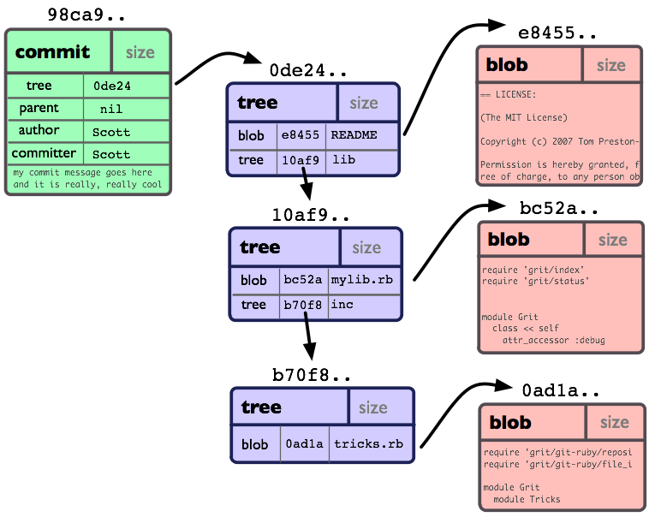
The Objects
If we had a simple project with the following directory structure:
$>tree
.
|-- README
`-- lib
|-- inc
| `-- tricks.rb
`-- mylib.rb
2 directories, 3 files
And we committed this
to a Git repository, it would
be represented like this:

Slide 6
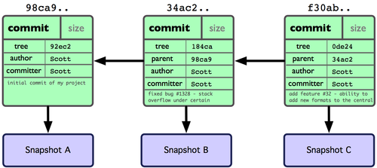
Branching
git object data for multiple commits

Slide 7
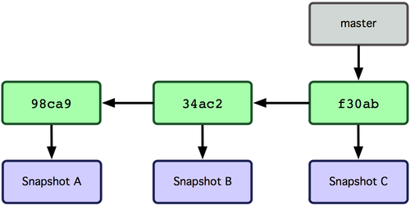
Branching
git object data for multiple commits

Slide 8
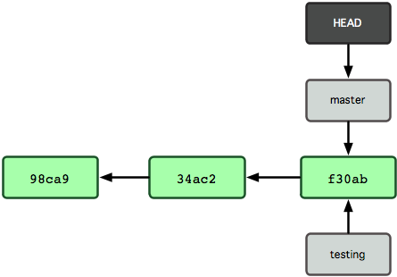
Branching
Multiple branches pointing into the commit’s data history.
HEAD file pointing to the branch you’re on.

Slide 9
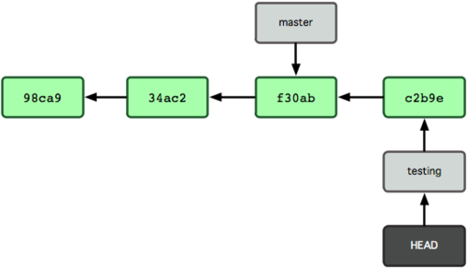
Branching
The branch that HEAD points to moves forward with each commit.

Slide 10
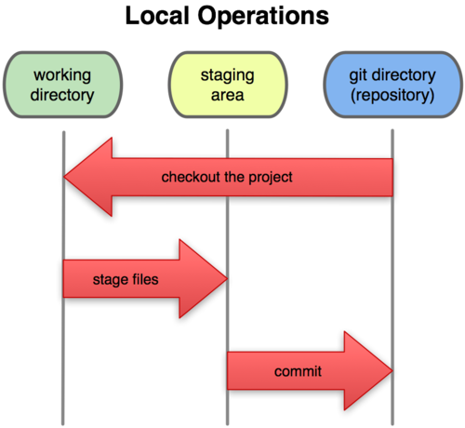
The Three States
Git has three main states that your files can reside in: committed, modified, and staged.
Committed means that the data is safely stored in your local database.
Modified means that you have changed the file but have not committed it to your database yet.
Staged means that you have marked a modified file in its current version to go into your next commit snapshot.

Slide 11
Basic workflow
The basic Git workflow goes something like this:
You modify files in your working directory.
You stage the files, adding snapshots of them to your staging area.
You do a commit, which takes the files as they are in the staging area and stores that snapshot permanently to your Git directory.

Slide 12
Git directory
The Git directory is where Git stores the metadata and object database for your project. This is the most important part of Git, and it is what is copied when you clone a repository from another computer.
Structure of .git directory
$>tree -L 1
.
|-- HEAD # pointer to your current branch
|-- config # your configuration preferences
|-- description # description of your project
|-- hooks/ # pre/post action hooks
|-- index # index file
|-- logs/ # a history of where your branches have been
|-- objects/ # your objects (commits, trees, blobs, tags)
`-- refs/ # pointers to your branches

Slide 13
Install git
Linux
http://git-scm.com/download
$ yum install git-core
$ apt-get instal git-core
Windows
http://code.google.com/p/msysgit
Mac
http://code.google.com/p/git-osx-installer

Slide 14
First-Time Git Setup
The first thing you're going to want to do is customize your Git environment. You should have to do these things only once
Git comes with a tool called git config that lets you get and set configuration variables that control all aspects of how Git looks and operates. These variables can be stored in three different places:
/etc/gitconfig file: Contains values for every user on the system and all their repositories. If you pass the option --system to git config, it reads and writes from this file specifically.
~/.gitconfig file: Specific to your user. You can make Git read and write to this file specifically by passing the --global option.
config file in the git directory (that is, .git/config) of whatever repository you’re currently using: Specific to that single repository. Each level overrides values in the previous level, so values in .git/config trump those in /etc/gitconfig.

Slide 15
First-Time Git Setup
Set up your name and email address for Git to use to sign your commits.
$ git config --global user.name "Scott Chacon"
$ git config --global user.email schacon@gmail.com
$ git config --global core.editor vim
$ git config --global merge.tool vimdiff
If you want to check your settings, you can use the
"git config -l" command to list all the settings.

Slide 16
Getting Help
If you need help while using Git, there are three ways to get the manual page (manpage) help for any of the Git commands:
$ git help <verb>
$ git <verb> --help
$ man git-<verb>
For example, you can get the man page help for the config command by running
$ git help config

Slide 17
Getting a Git Repository
Initializing a Repository in an Existing Directory
If you’re starting to track an existing project in Git, you need to go to the project’s directory and type
$ git init
Cloning an Existing Repository
If you want to get a copy of an existing Git repository — for example, a project you’d like to contribute to — the command you need is git clone.
$ git clone git://github.com/schacon/grit.git
$ git clone git://github.com/schacon/grit.git mygrit

Slide 18
Gitignore
A gitignore file specifies intentionally untracked files that git should ignore.
Files already tracked by git are not affected.
git command
.gitignore
$GIT_DIR/info/exclude
configuration variable core.excludesfile

Slide 19
Git branch
Create branch
$ git branch <branchname> [<start-point>]
List branch
$ git branch [-r | –a] [–l] –v
Rename branch
$ git branch (-m | -M) <oldbranch> <newbranch>
Remove branch
$ git branch (-d | -D) [-r] <branchname>

Slide 20
Git checkout
Switch to an existed branch
$ git checkout <branch>
Create new branch
$ git checkout -b <new_branch> [<start_point>]
Similar as:
$ git branch <new_branch> & git checkout <new_branch>
Unmodifying a Modified File
$ git checkout -- <file>

Slide 21
Git status
Displays paths that have differences between the index file and the current HEAD commit, paths that have differences between the working tree and the index file, and paths in the working tree that are not tracked by git .
$ git status [<pathspec>]

Slide 22
Git add
Tracking new file
$ git add <filepattern>
Interactive
$ git add [--interactive | -i]

Slide 23
Git rm
Remove files from the index, or from the working tree and the index.
$ git rm [-f | --force] [-r] [--cached] <file>

Slide 24
Git diff
Diff uncached changes
$ git diff
Diff cached changes
$ git diff --cached
Diff the named paths
$ git diff [<commit>] [<commit>] <path>

Slide 25
Git commit
Stores the current contents of the index in a new commit along with a log message from the user describing the changes.
Committing your commit
$ git commit
$ git commit [-a] [-m <msg>]
(Notice: the commit only affect in your local workspace)
Changing your last commit
$ git commit --amend

Slide 26
Git log
Show the commit log.
$ git log <branch> [files]
$ git log -<n>
$ git log <since>..<until>
$ git log <since>…<until> --left-right
$ git log --format=<format>

Slide 27
Git fetch
Fetches named heads or tags from one or more other repositories, along with the objects necessary to complete them.
$ git fetch <repository> <refspec>
Format of <refspec>:
<src>:<dst>

Slide 28
Git merge
Incorporates changes from the named commits into the current branch.
$ git merge <commit>
Merge methods:
Fast forward
Merge made by recursive.

Slide 29
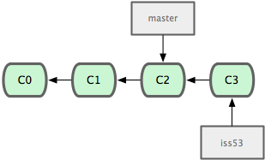
Fast Forward
$ git checkout master
$ git merge iss53
Updating f42c576..3a0874c
Fast forward
README | 1 –
1 files changed, 0 insertions(+), 1 deletions(-)

Slide 30
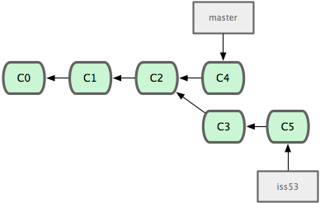
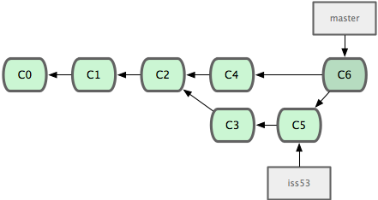
Merge by recursive
C6 is a special commit,
called “merge commit”.
$ git checkout master
$ git merge iss53
Merge made by recursive.
README | 1 +
1 files changed, 1 insertions(+), 0 deletions(-)

Slide 31
Conflict
$ git merge iss53
Auto-merging index.html
CONFLICT (content): Merge conflict in index.html
Automatic merge failed; fix conflicts and then commit the result.
<<<<<<< HEAD:index.html
<div id="footer">contact : email.support@github.com</div>
=======
<div id="footer"> please contact us at support@github.com </div>
>>>>>>> iss53:index.html

Slide 32
Git rebase
Forward-port local commits to the updated upstream head
$ git rebase -i | --interactive <upstream>
$ git rebase --onto <newbase> <upstream> <branch>
$ git rebase --continue | --skip | --abort

Slide 33
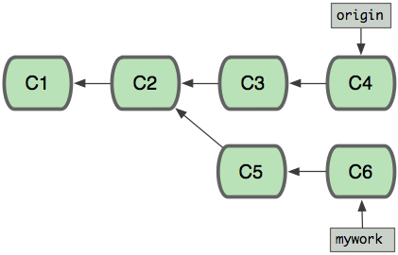
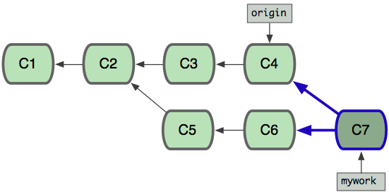
Difference between merge and rebase
orgin
merge

Slide 34
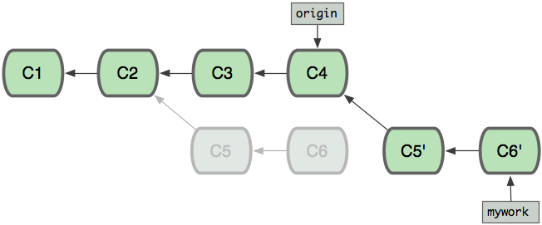
Difference between merge and rebase
orgin
rebase

Slide 35
Git cherry-pick
Given one or more existing commits, apply the change each one introduces, recording a new commit for each.
$ git cherry-pick <commit>

Slide 36
Git apply
Reads the supplied diff output (i.e. "a patch") and applies it to files.
$ git apply <patch>

Slide 37
Git pull
Incorporates changes from a remote repository into the current branch.
In its default mode, git pull is shorthand for git fetch followed by git merge FETCH_HEAD.
More precisely, git pull runs git fetch with the given parameters and calls git merge to merge the retrieved branch heads into the current branch. With --rebase, it runs git rebase instead of git merge.
$ git pull <repository> [<refspec>]
Simliar as:
$ git fetch & git merge FETCH_HEAD

Slide 38
Git push
Updates remote refs using local refs, while sending objects necessary to complete the given refs.
$ git push [-f] <repository> [<refspec>]
Format of <refspec>:
<src>:<dst>
The <src> is often the name of the branch you would want to push, but it can be any arbitrary "SHA-1 expression".
If :<dst> is omitted, the same ref as <src> will be updated.
Pushing an empty <src> allows you to delete the <dst> ref from the remote repository.

Slide 39
Git reset
Reset current HEAD to the specified state.
$ git reset [--soft | --hard] <commit> <path>
--soft
Does not touch the index file nor the working tree at all (but resets the head to <commit>, just like all modes do). This leaves all your changed files "Changes to be committed", as git status would put it.
--hard
Resets the index and working tree. Any changes to tracked files in the working tree since <commit> are discarded.

Slide 40
Git revert
Given one or more existing commits, revert the changes that the related patches introduce, and record some new commits that record them.
$ git revert <commit>

Slide 41
Git clean
Cleans the working tree by recursively removing files that are not under version control, starting from the current directory.
$ git clean -fxd
-d Remove untracked directories .
-f Force remove.
-x Don’t use the ignore rules.

Slide 42
Git tag
Create, list, delete or verify a tag object signed with GPG.
Create tag
$ git tag [-a |-s] [-m <msg>] <tagname> [<commit>]
-a
Make an unsigned, annotated tag object
-s
Make a GPG-signed tag, using the default e-mail address’s key
Delete tag
$ git tag –d <tagname>

Slide 43
Reference
http://www.kernel.org/pub/software/scm/git/docs/
http://book.git-scm.com/
http://progit.org/book/zh/

Slide 44

Thank you

